Slide 1
Is Accounting Still on Accounts?
Challenges for Accountants and Auditors
prof. Radosław Ignatowski
University of Łódź
Accountants Association in Poland (SKwP)
Presentation (short) prepared for 26th International Congress of
The Association of Accountants and Auditors of Republic of Srpska (SRRRS)
Banja Vrućica, 14-16 September 2022

Slide 2
What can we expect from Accounting?
Accounting is the art of recording, classifying and summarizing in a significant manner and in terms of money, transactions and events which are in part at least, of a financial character and interpreting the results thereof.
[American Institute of Certified Public Accountants, AICPA, 1941]
Accounting – the process (a system) of identifying, measuring and communicating information about the financial position and financial performance of business entities, serving its users in making economic decisions, mainly in the field of allocation, use and distribution of theirs economic resources.
Definition based on: [AAA, 1966; A. Jarugowa, 1991]

Slide 3




What can we expect from Accounting?
Accounting – a system, which is trying to reproduce (or reflect) the economic reality of the object – processes related to the allocation, use and distribution of economic resources.
Is it possible, however, to reproduce (or reflect) the reality uniformly by any process or system of description and measurement?
3

Slide 4
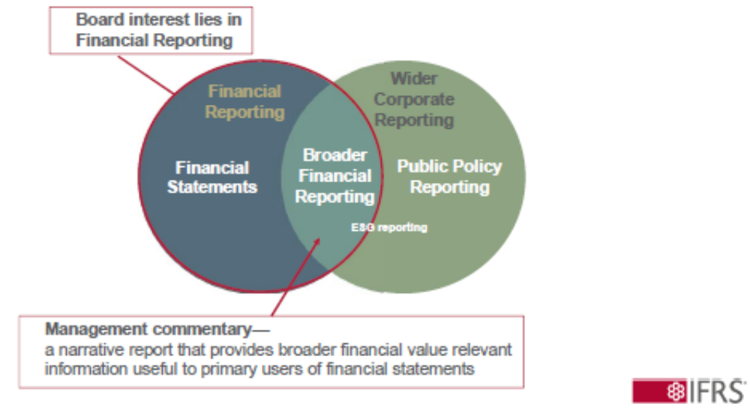
What can we expect from Financial Reporting?
  Relations among Financial Statements, Financial Reporting and
  Corporate Reporting
IASB and IFRS
Corporate Social Responsibility
Integrated Reporting
IFRS Foundation has started to develop International Sustainability Standards Board, ISSB
High quality, transparent, reliable and comparable reporting by companies on climate and other environmental, social and governance (ESG) matters.
Prof. nadzw. dr hab. Radosław Ignatowski, Uniwersytet Łódzki

Slide 5
How Accounting should Run?
Entity’s Accounting Influences
Elements: Theory, Regulations and Practice within Accounting
Environment
Natural, Social, Political, Economic, Legal
Regulations
Legal and/or
Professional
Entity
Theory
Conceptual scientific literature
Empirical research
Best Practice

Slide 6
How Accounting should Run?
Accounting regulations and Practice
Elements: Theory, Regulations and Practice within Accounting
Theory
Practice
Regula
tions
Accounting and Auditing Profession should care about proper system construction, incl. proportions – technical and personal

Slide 7
How Accounting should Run?
Accounting Regulations and Practice
Current Trends in Accounting Regulatory Systems
Legal Regulations
National Accounting Standards
IFRS
Develop them as much as Possible
Make them Narrow as Possible
Principles instead of Rules
Use them
Rationally
Notes:
7

Slide 8
What can we expect from this Congress?
Compliments to the Organizers for that important Event.
Thanks for Invitation
Wishes of Success
Greetings from Polish Accountants and Auditors Society

